Slide 1
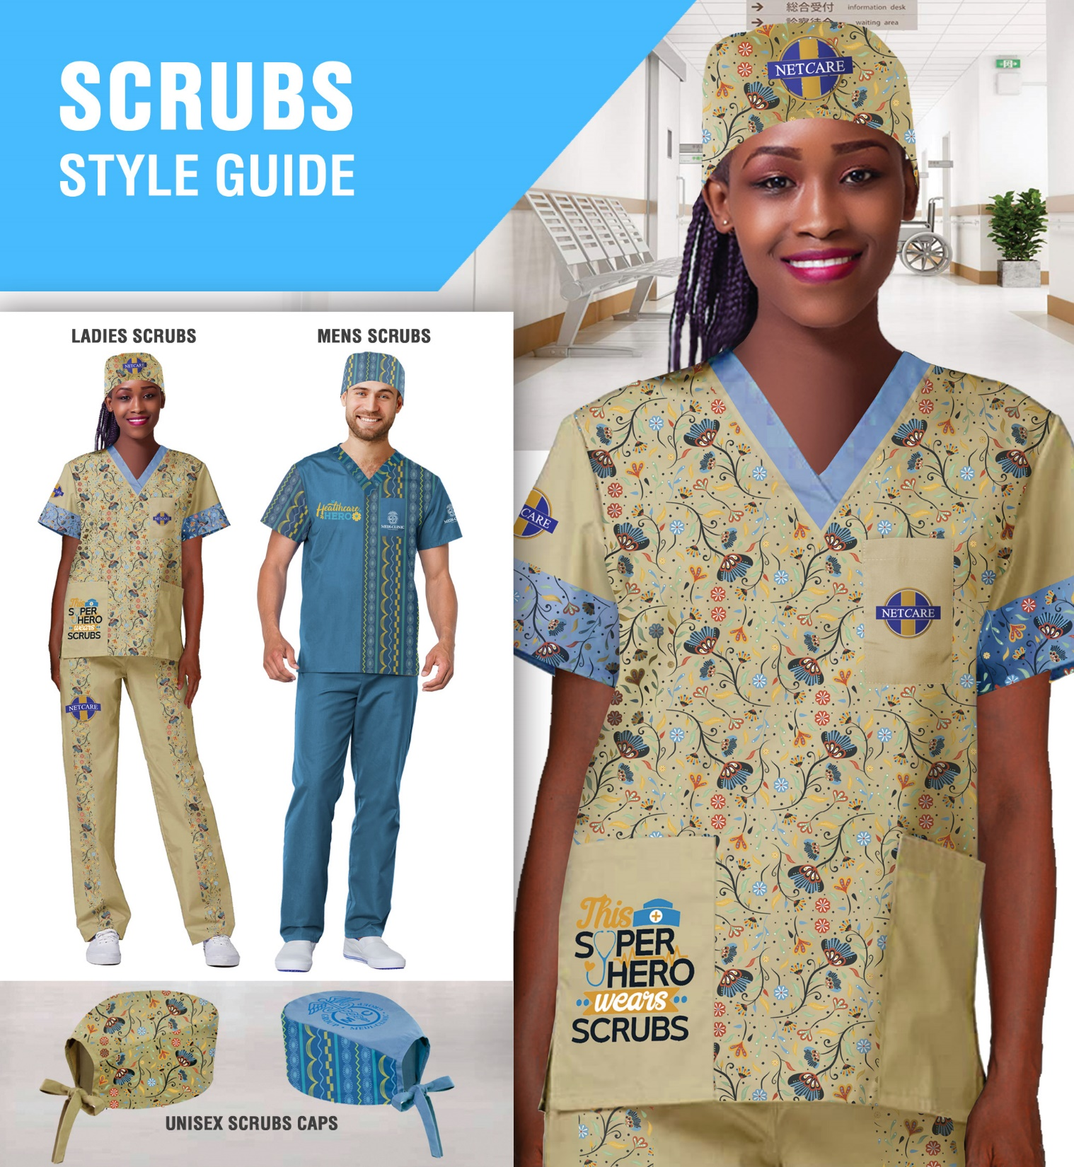
Medical Scrubs
Including 3D and 360 rotating view
(right click on the icon to view video)
2021-2022
Add your logo here

Slide 2
Our Categories
Scrubs
Our Sublimated, full colour scrubs are an easy way to bring colour to medical staff uniforms and brighten up their patients day. They can be branded with fill colour patterns that are vibrant and funky and will put young and nervous patients at ease. Brand them with colourful patterns , animation character's, flowers or themes such as Christmas and add the hospital or medical practice name.

Slide 3


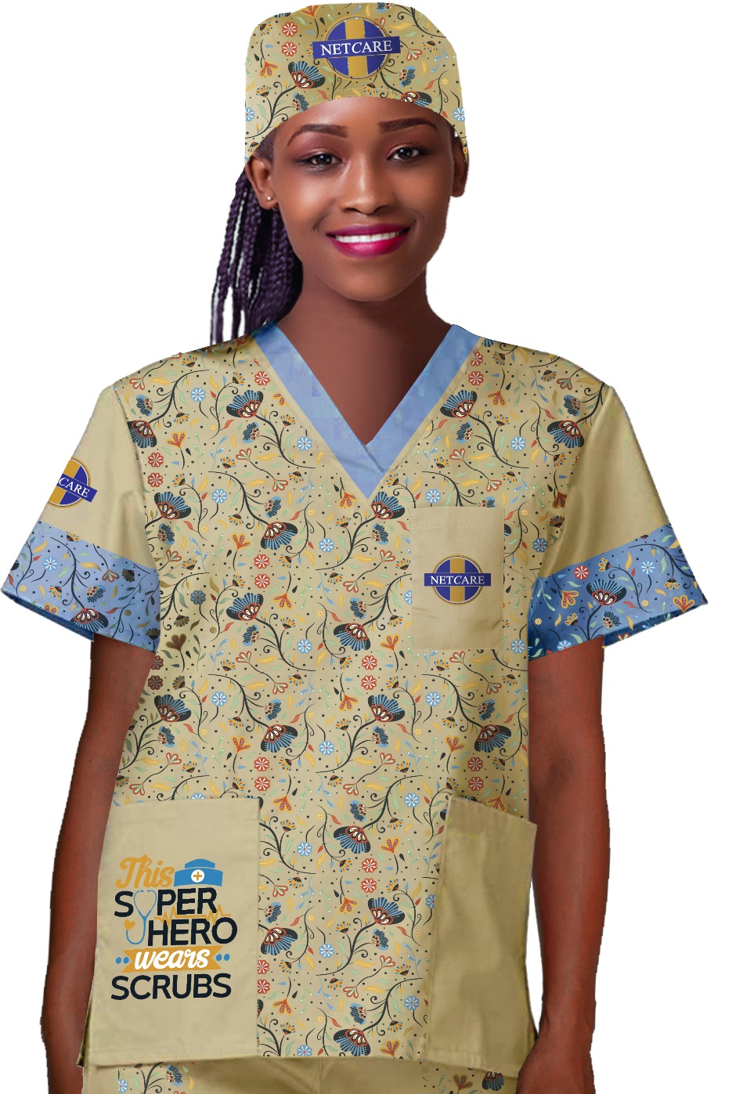
Medical Scrubs - Tops
Ladies V-neck Scrub Top with Full Colour Print
Product Code : APP432
Branding: Custom Design Full Colour Included in Price
Material: Polyester
Sizes: XS,S,L,XL,2XL,3XL,4XL,5XL

Slide 4
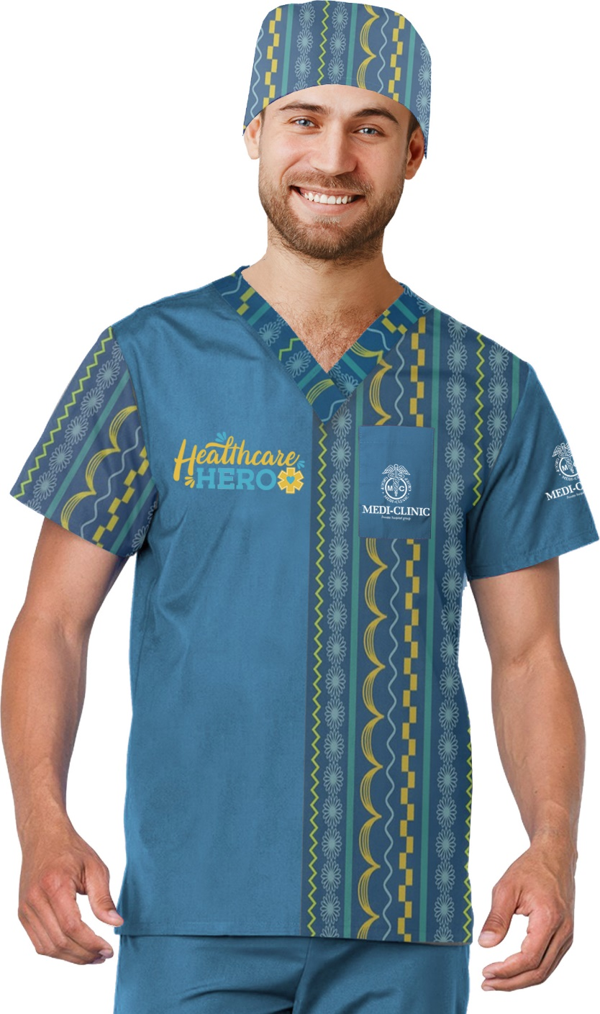
Medical Scrubs – Tops
Mens V-neck Scrub Top with Full Colour Print
Product Code : APP433
Branding: Custom Design Full Colour Included in Price
Material: Polyester
Sizes: XS,S,L,XL,2XL,3XL,4XL,5XL

Slide 5
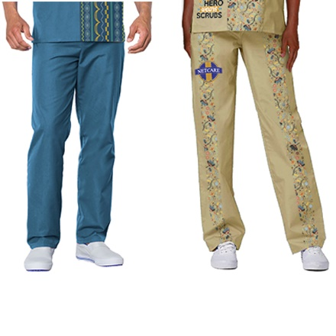
Medical Scrubs – Unisex Scrub Pants
Unisex Scrub Pants with Full Colour Print
Product Code : APP434
Branding: Custom Design Full Colour Included in Price
Material: Polyester
Sizes: XS,S,L,XL,2XL,3XL,4XL,5XL

Slide 6
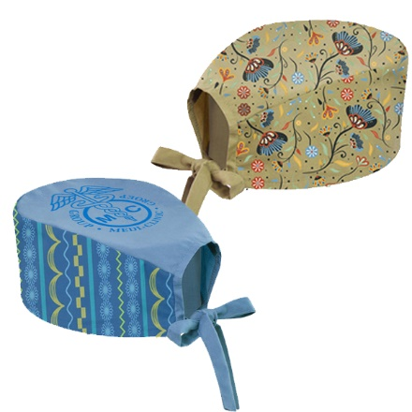
Medical Scrubs
Unisex Scrub Caps with Full Colour Print
Product Code : APP435
Branding: Custom Design Full Colour Included in Price
Material: Polyester
Sizes: One Size fits all

