Slide 1
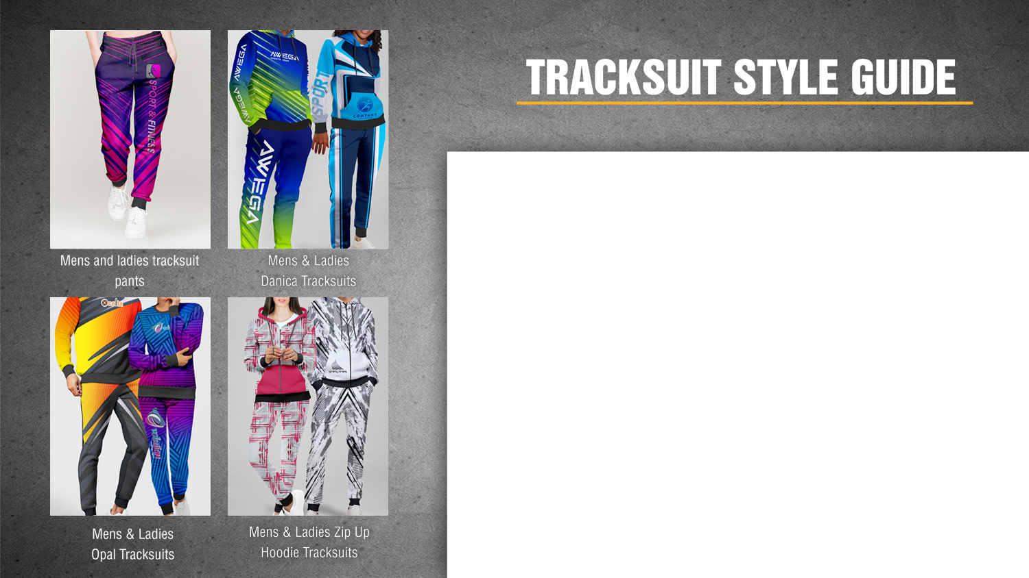
Brushed Fleece
Tracksuits and Tracksuit pants
100% Print Coverage | Stylish and comfy to notch up your athleisure style
The tracksuits are available in 3 styles. As they are fully sublimated products, they allow for unlimited printing of colours, designs, and logos at no additional cost.

Slide 2
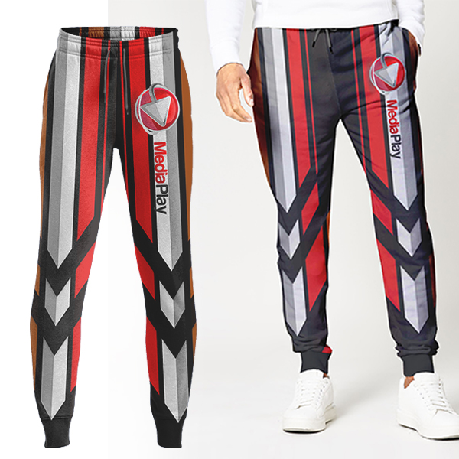
Mens Colson Tracksuit pants with Sublimation Print
Product Code :APP7300
Branding: Custom Design Full Color Included
in Price
Material: 240g/m2 brushed fleece
Extras: Ribbing available in white or black.
SIZES : S,M,L,XL,2XL,3XL,4XL,5XL
Price: R

Slide 3
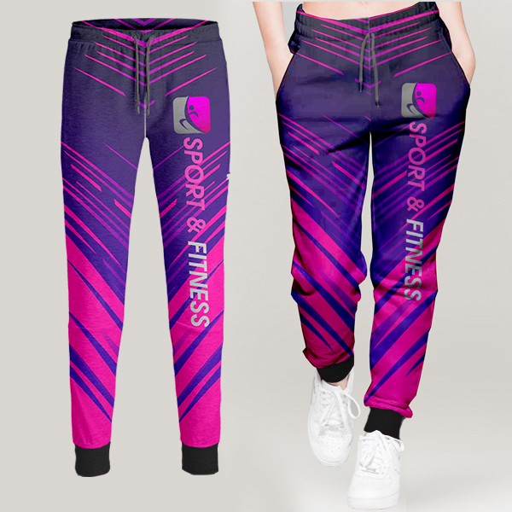
Ladies Colson Tracksuit Pants with Sublimation Print
Product Code : APP7301
Branding: Custom Design Full Colour Included in Price
Material: 240g/m2 brushed fleece
Extras: Ribbing available in white or black.
SIZES : XS, S,M,L,XL,2XL,3XL,4XL,5XL
Price: R

Slide 4
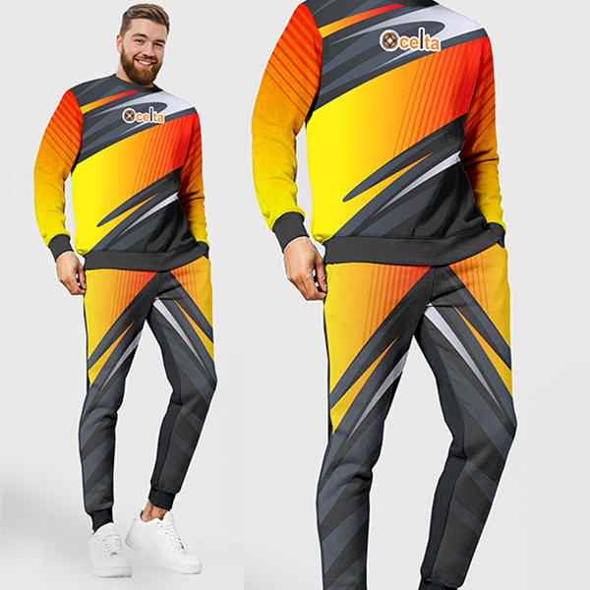
Mens Opal Brushed Fleece Tracksuits set with Sublimation Print
Product Code : APP7304
Branding: Custom Design Full Colour Include in Price
Material: 240g/m2 brushed fleece
Extras: Ribbing available in white or black.
SIZES : S,M,L,XL,2XL,3XL,4XL,5XL
Price: R

Slide 5
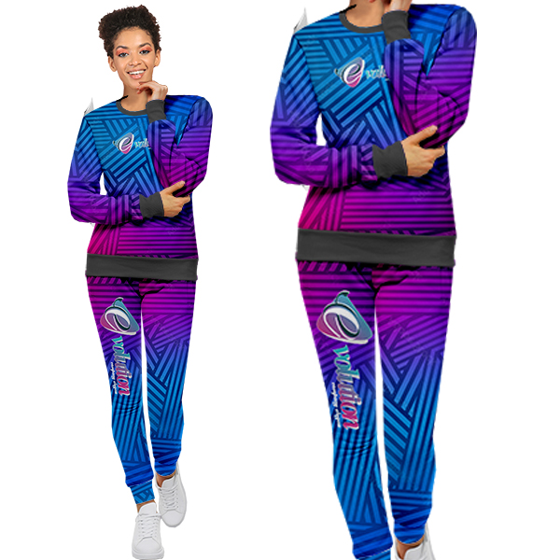
Ladies Opal Brushed Fleece Tracksuits set with Sublimation Print
Product Code : APP7305
Branding: Custom Design Full Colour Included in Price
Material: 240g/m2 brushed fleece
Extras: Ribbing available in white or black.
SIZES : XS, S,M,L,XL,2XL,3XL,4XL,5XL
Price: R

Slide 6
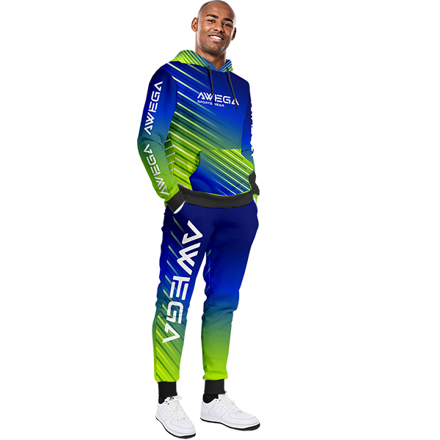
Mens Danica Brushed Fleece Tracksuits set with Sublimation Print
Product Code : APP7306
Branding: Custom Design Full Colour Included in Price
Material: 240g/m2 brushed fleece
Extras: Ribbing available in white or black.
SIZES : S,M,L,XL,2XL,3XL,4XL,5XL
Price: R

Slide 7
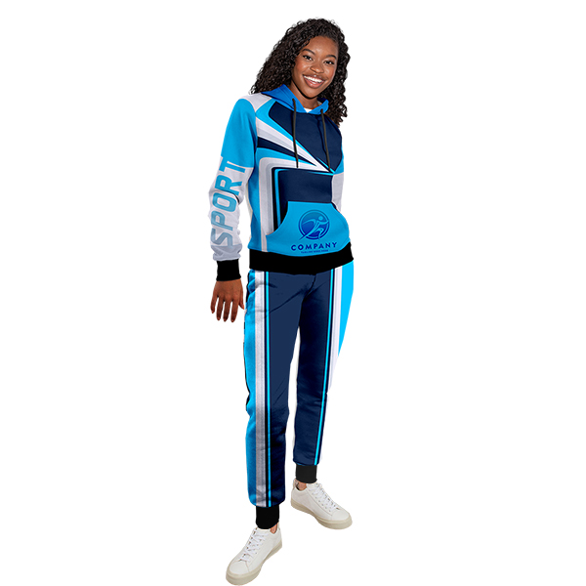
Ladies Danica Brushed Fleece Tracksuits set with Sublimation Print
Product Code : APP7307
Branding: Custom Design Full Colour Included
in Price
Material: 240g/m2 brushed fleece
Extras: Ribbing available in white or black.
SIZES : XS, S,M,L,XL,2XL,3XL,4XL,5XL
Price:

Slide 8
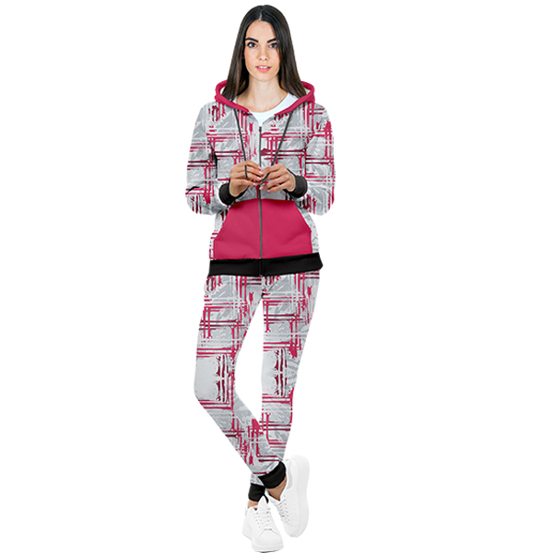
Ladies Nova Brushed Fleece Tracksuit set with Sublimation Print
Product Code : APP7309
Branding: Custom Design Full Colour Included in Price
Material: 240g/m2 brushed fleece
Extras: Ribbing available in white or black.
SIZES : XS, S,M,L,XL,2XL,3XL,4XL,5XL
Price: R

Slide 9
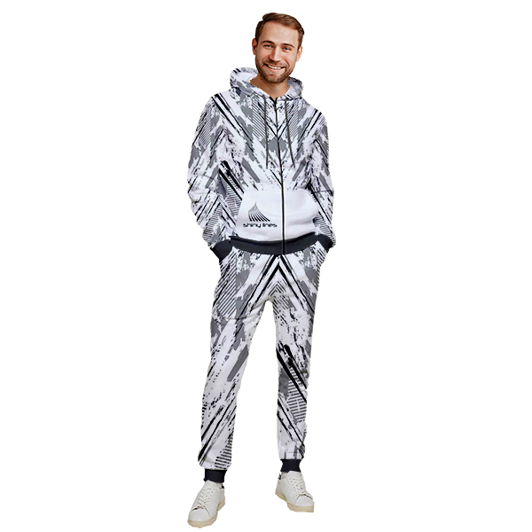
Mens Nova Brushed Fleece Tracksuit set with Sublimation Print
Product Code : APP7308
Branding: Custom Design Full Colour Included in Price
Material: 240g/m2 brushed fleece
Extras: Ribbing available in white or black.
SIZES : S,M,L,XL,2XL,3XL,4XL,5XL
Price: R

