Slide 1
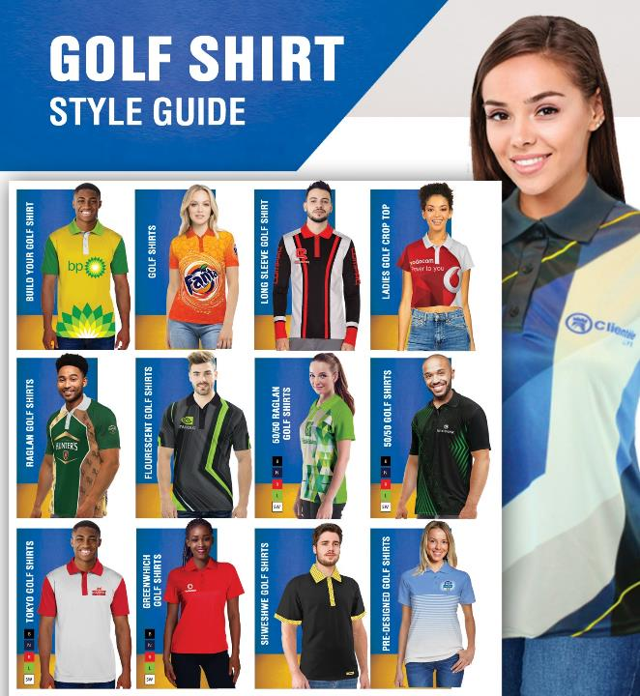
Mens and Ladies Golf Shirts
Including 3D 360 rotating view
(right click on the icon to view video)
2021-2022
Place your logo here

Slide 2
Our Categories
Golf Shirts
Enhance the image of your business and workforce with Golf Shirts that are sublimated Edge to Edge. They are perfect for any business looking to take advantage of the practicality , professionalism and higher-end look Golf Shirts convey.

Slide 3

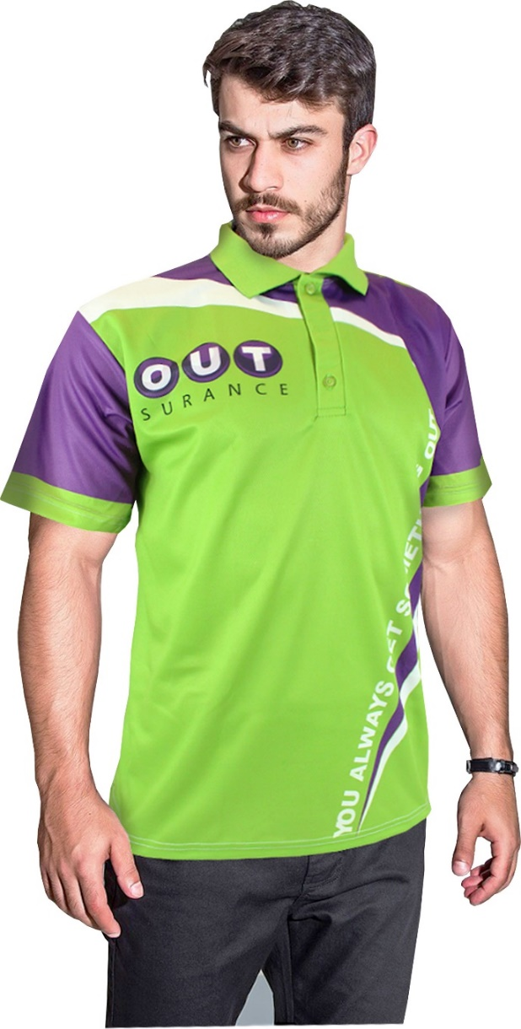
Golf Shirts - Edge to Edge Branding
Men’s Takoma Moisture Management Sublimation Golf Shirt
Product Code : APP10013
Branding: Custom Design Full Colour Included in Price
Material: 150g Polyester Interlock
Sizes: S,M,L,XL,2XL,3XL,4XL,5XL
Price: From R185,13

Slide 4

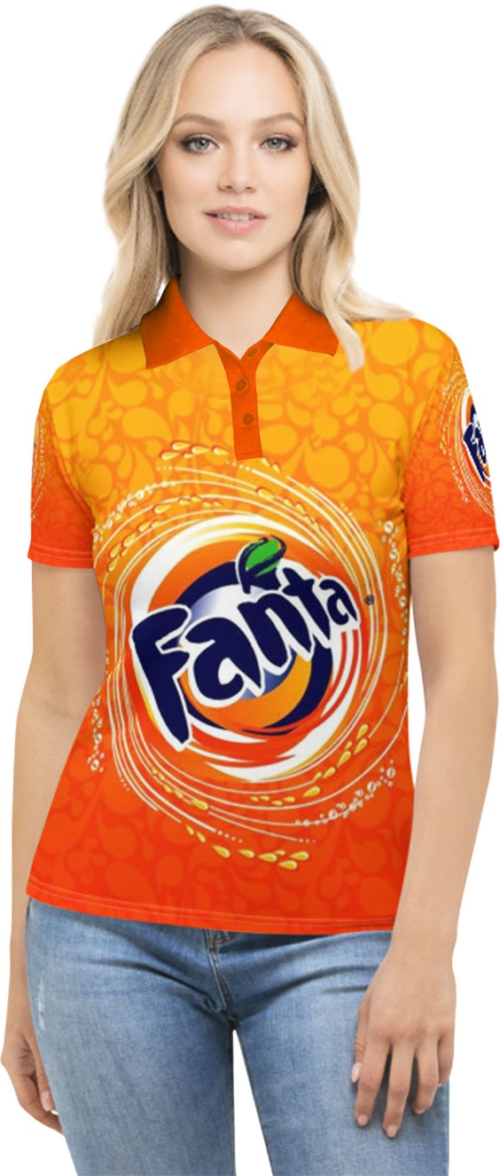
Golf Shirts – Edge to Edge Branding
Ladies Takoma Moisture Management Sublimation Golf Shirt
Product Code : APP10014
Branding: Custom Design Full Colour Included in Price
Material: 150g Polyester Interlock
Sizes: S,M,L,XL,2XL,3XL,4XL,5XL
Price: From R185,13

Slide 5

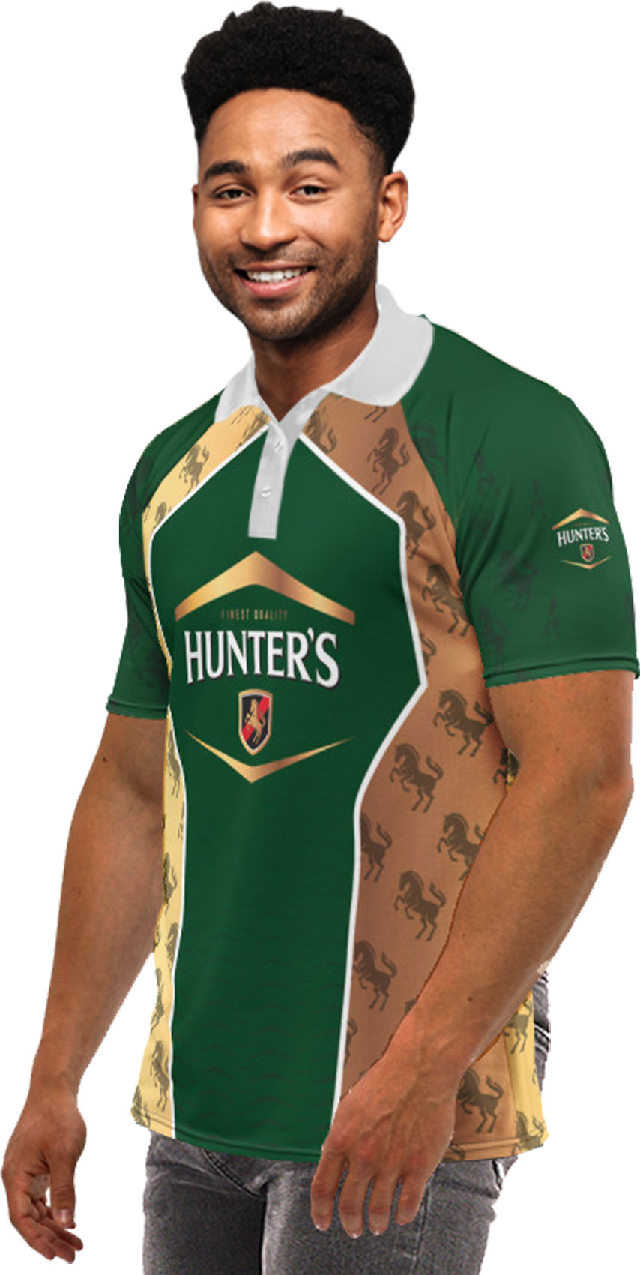
Unisex Golf Shirts – Edge to Edge Branding
Unisex Raglan Short Sleeve Golf Shirt with Sublimation Print
Product Code : APP307
Branding: Custom Design Full Colour Included in Price
Material: 150g Polyester Interlock
Sizes: S,M,L,XL,2XL,3XL,4XL,5XL
Price: From R185,13

Slide 6
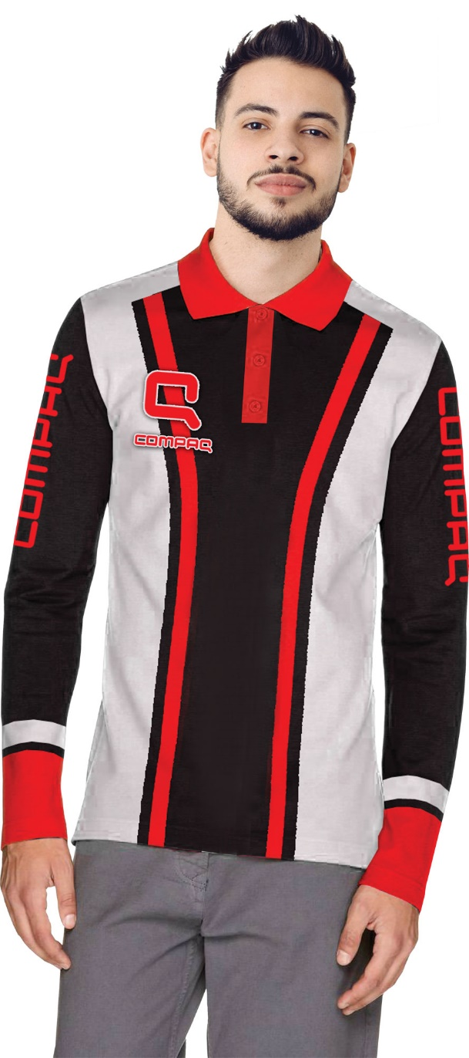
Golf Shirts – Long Sleeve – Edge to Edge Branding
Mens Basel Moisture Management Long Sleeve Sublimation Golf Shirt
Product Code : APP10095
Branding: Custom Design Full Colour Included in Price
Material: 150g Polyester Interlock
Sizes: S,M,L,XL,2XL,3XL,4XL,5XL
Price: From R200,00

Slide 7
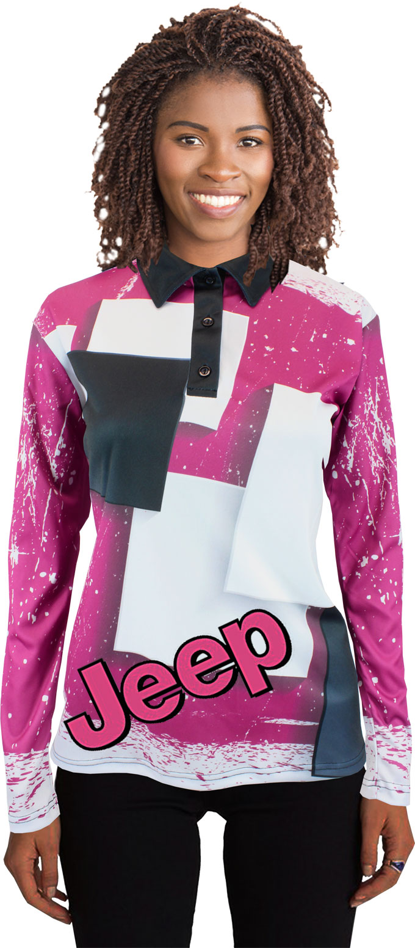
Golf Shirts – Long Sleeve – Edge to Edge Branding
Ladies Basel Moisture Management Long Sleeve Sublimation Golf Shirt
Product Code : APP10097
Branding: Custom Design Full Colour Included in Price
Material: 150g Polyester Interlock
Sizes: S,M,L,XL,2XL,3XL,4XL,5XL
Price: From R200,00

Slide 8
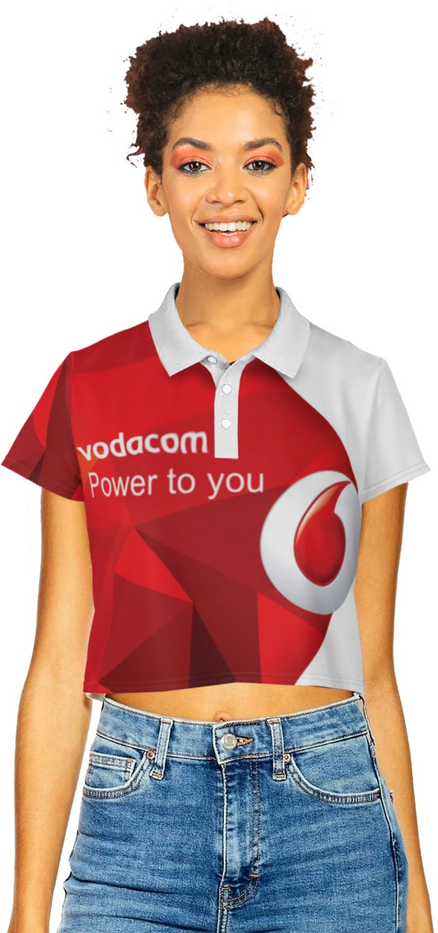
Golf Shirts – Crop Top Edge to Edge Branding
Ladies Moisture Management Sublimation Golf Crop Top Shirt
Product Code : APP305
Branding: Custom Design Full Colour Included in Price
Material: 150g Polyester Interlock
Sizes: XS,S,M,L,XL,2XL,3XL,4XL,5XL
Extras: Length of Crop Shirt can be adjusted as Required
Price: From R200,00

Slide 9
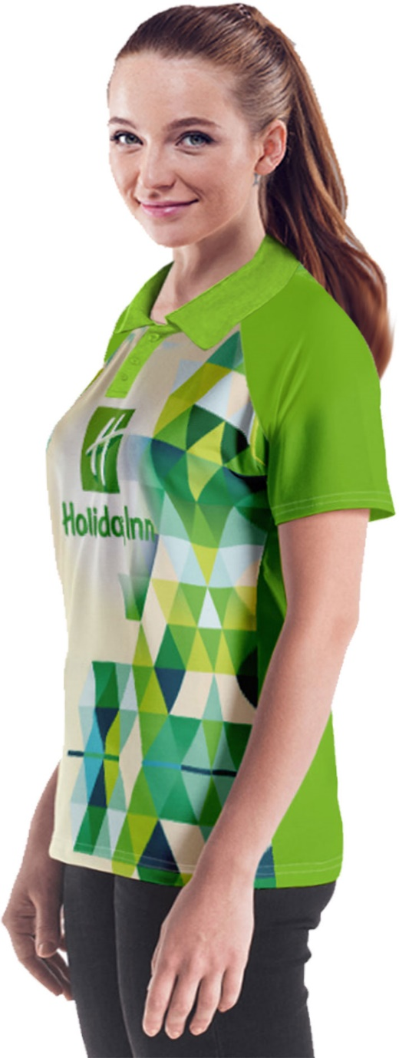
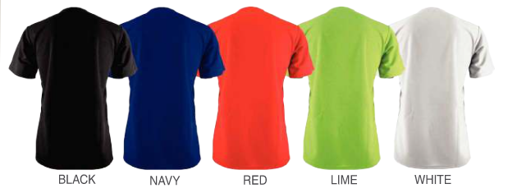
Unisex Golf Shirts – 50/50 Full colour on front only
Unisex 50/50 Short Sleeve Raglan Golf Shirt
Product Code : APP309
Branding: Custom Design Full Colour Included in Price
Material: 150g Polyester Interlock
Sizes: S,M,L,XL,2XL,3XL,4XL,5XL
Price: From R125,00

Slide 10
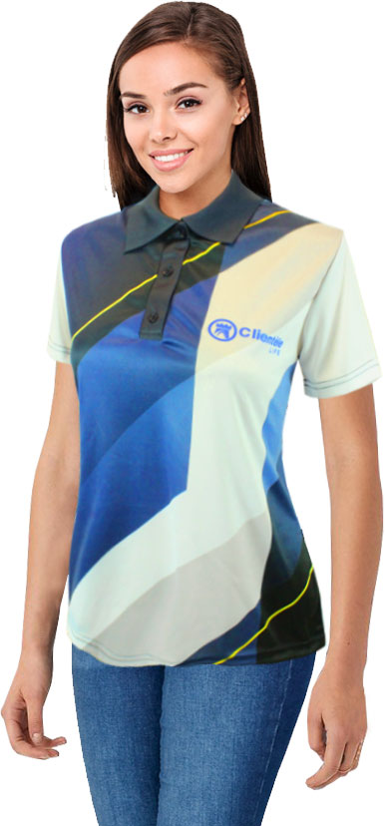
Golf Shirts – 50/50 Full colour on front only
Ladies 50/50 Moisture Management Long Sleeve Sublimation Golf Shirt
Product Code : APP50025
Branding: Custom Design Full Colour Included in Price
Material: 150g Polyester Interlock
Sizes: S,M,L,XL,2XL,3XL,4XL,5XL
Price: R115,00

Slide 11

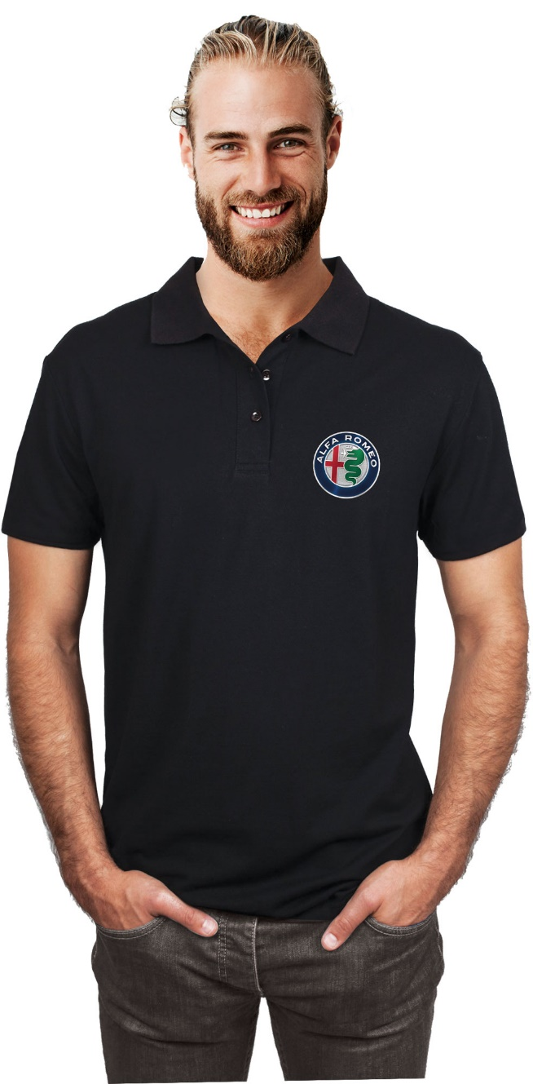
Golf Shirts – DDT Print Full colour 1 Position
Men’s Greenwhich Moisture Management Golf Shirt with Full Colour DDT print
Product Code : APP1008A
Branding: Custom Design Full Colour Included in Price
Material: 150g Polyester Birdseye
Variants: Black, Navy, Lime, Red, Solid White
Sizes: S,M,L,XL,2XL,3XL,4XL,5XL
Extras: Free DDT Branding
Price: R87,99

Slide 12

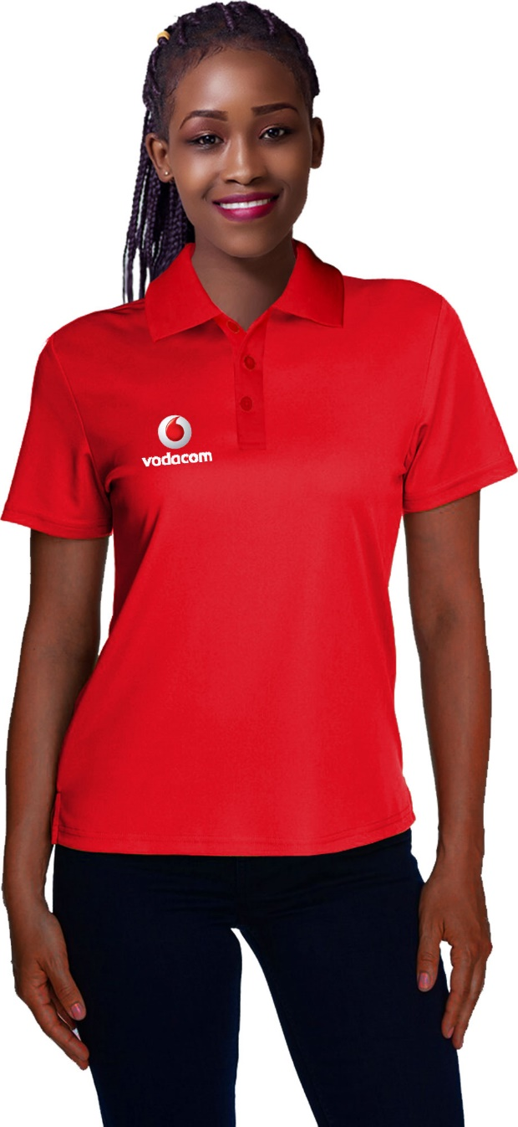
Golf Shirts – DDT Print Full colour 1 Position
Ladies Greenwhich Moisture Management Golf Shirt with Full Colour DDT print
Product Code : APP1009A
Branding: Custom Design Full Colour Included in Price
Material: 150g Polyester Birdseye
Variants: Black, Navy, Lime, Red, Solid White
Sizes: S,M,L,XL,2XL,3XL,4XL,5XL
Extras: Free DDT Branding
Price: R87,99

Slide 13
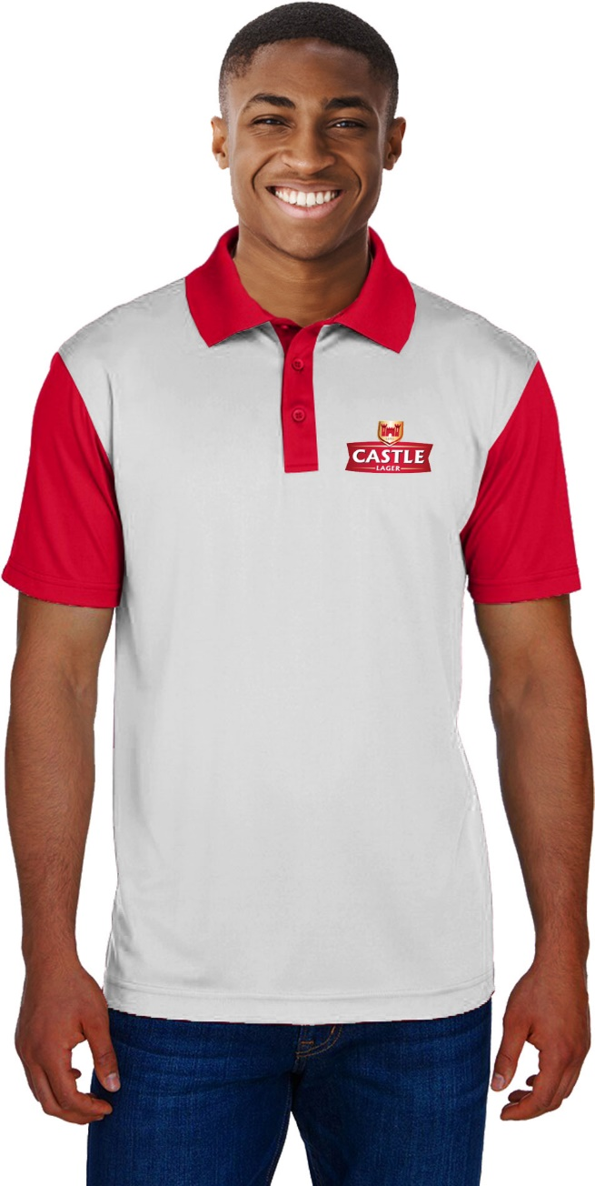
Golf Shirts – Spot Sublimation Print
Men’s Tokyo Moisture Management Golf Shirt
Product Code : APP7013
Branding: Custom Design Full Colour Included in Price
Material: 150g Polyester Birdseye
Variants: Black, Navy, Lime, Red, Solid White
Sizes: S,M,L,XL,2XL,3XL,4XL,5XL
Extras: Free Spot Sublimation Branding
Price: R154,00

Slide 14
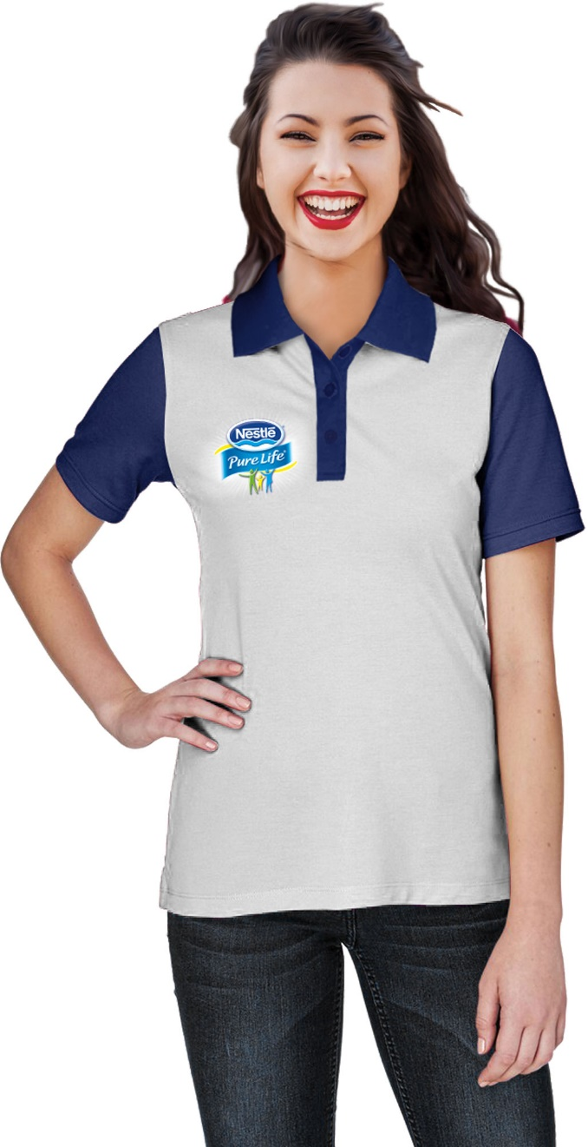
Golf Shirts – Golf Shirts – Spot Sublimation Print
Ladies Tokyo Moisture Management Golf Shirt
Product Code : APP7011
Branding: Custom Design Full Colour Included in Price
Material: 150g Polyester Birdseye
Variants: Black, Navy, Lime, Red, Solid White
Sizes: S,M,L,XL,2XL,3XL,4XL,5XL
Extras: Free Spot Sublimation Branding
Price: R154,00

Slide 15
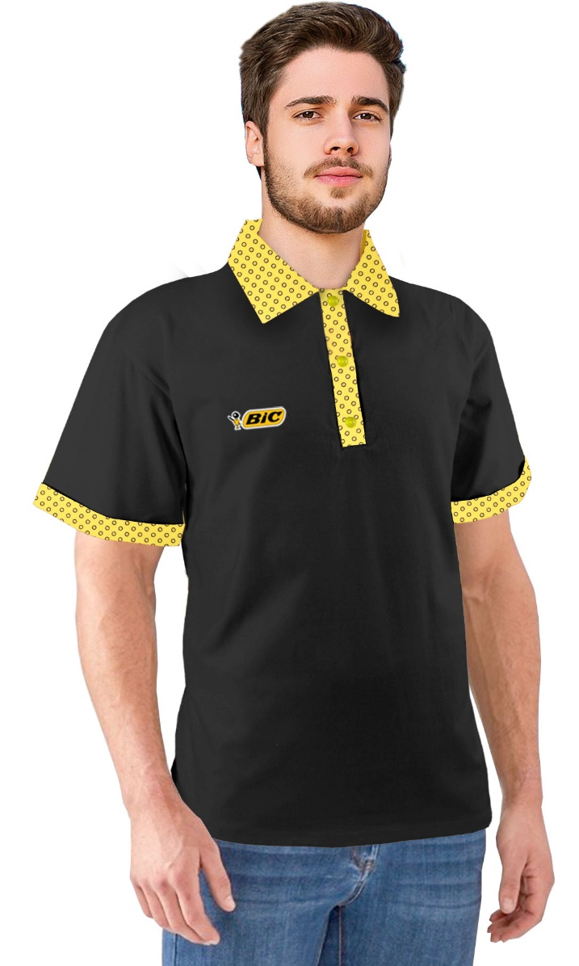
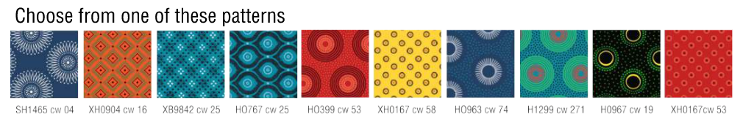
Golf Shirts – Shweshwe Trimming
Men’s Golf Shirt with Shweshwe Trimming
Product Code : APP7021
Branding: Custom Design Full Colour Tag included in price
Material: 180g Cotton and Shweshwe
Sizes: S,M,L,XL,2XL,3XL,4XL,5XL
Extras: Free Full Colour label for subtle Branding
Price: R177,45

Slide 16
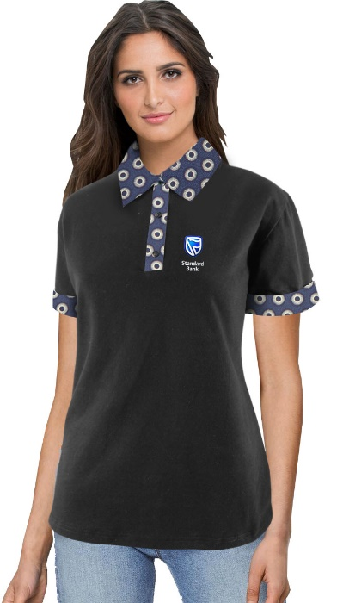
Golf Shirts – Shweshwe Trimming
Ladies Golf Shirt with Shweshwe Trimming
Product Code : APP7022
Branding: Custom Design Full Colour Tag included in price
Material: 180g Cotton and Shweshwe
Sizes: S,M,L,XL,2XL,3XL,4XL,5XL
Extras: Free Full Colour label for subtle Branding
Price: R177,45

